Slide 1

Welcome!
Freshman Parent Night
CLASS OF 2028

Slide 2

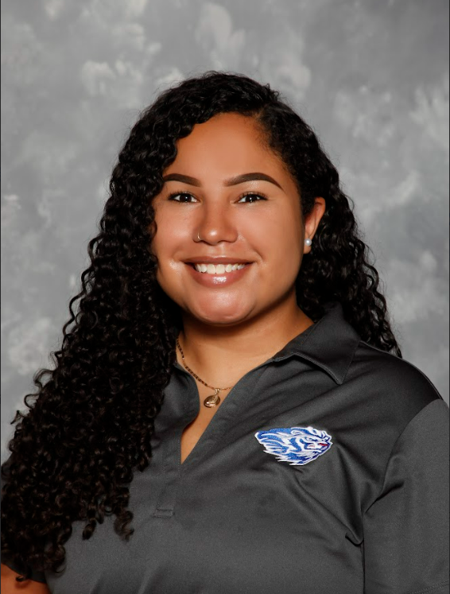
9th Grade Counselors
Wanda Merchant Aubrey Banks
Counselor (A-L) Counselor (M-Z)

Slide 3
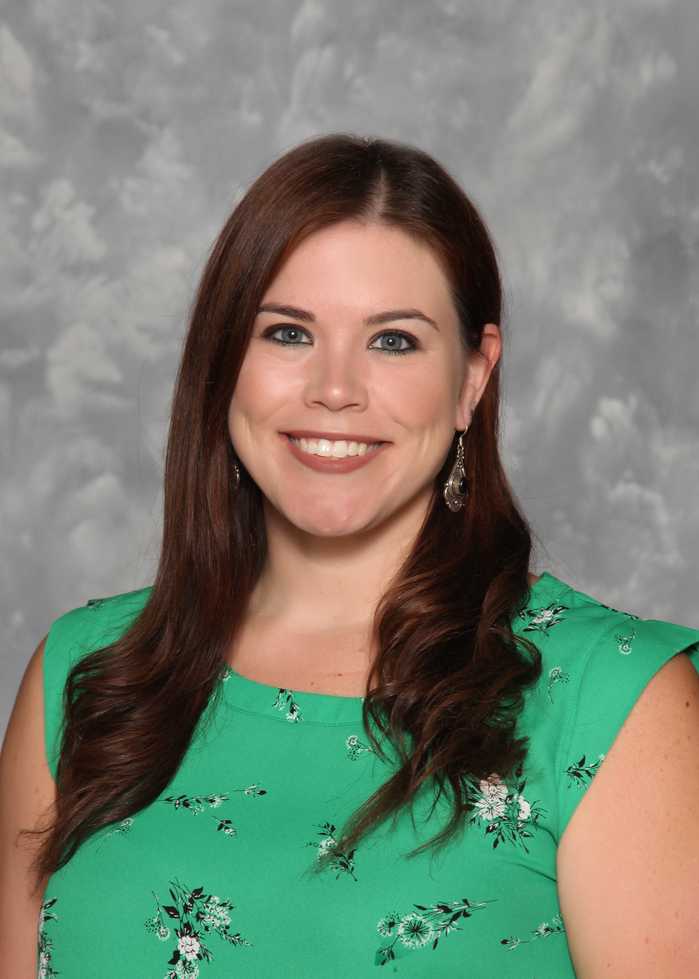
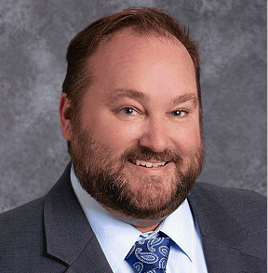
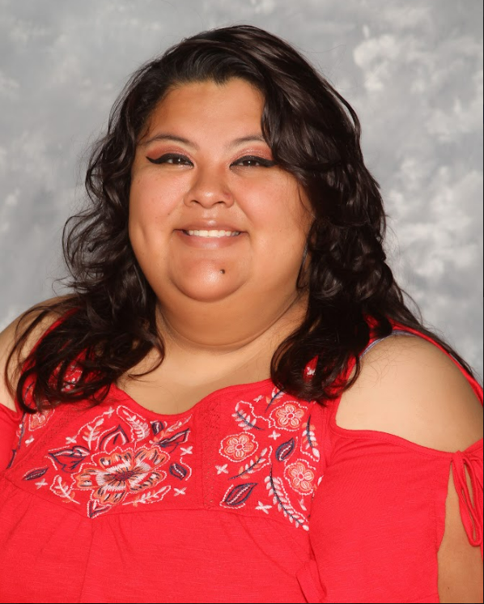
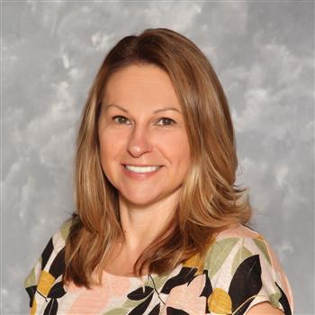
9th Grade Assistant Principals
9th Grade Clerical Support
Dr. Brittany Devitt Mr. Sean O'Connor Ms. Ana Badillo- Mejia Ms. Sonja Bowen

Slide 4
Topics to Cover
High School Basics & Planning
Registration Timeline
AP versus Dual Enrollment
HOPE Scholarship vs. HOPE Grant
HOPE GPA
What matters most in college admissions?
College admission requirements/freshman profiles
Timeline: Suggestions to help prepare students

Slide 5
Graduation Requirements
English | 9th L.A. | 10th L.A. | 11th L.A. | 12th L.A.
Math* | Algebra | Geometry | Advanced Algebra | 4th Math Option
Science | Biology | Chemistry | Physics | 4th Science Option
Social Studies |  | World History | U.S. History | Economics/ American Gov
Electives | Health/PE | CTE/Fine Arts or Foreign Language | CTE/Fine Arts or Foreign Language | CTE/Fine Arts or Foreign Language
Electives | General Elective | General Elective | General Elective | General Elective
*Math pathway may vary per student placement
*23 credits total needed for graduation
*2 credits of foreign language needed for most college admissions

Slide 6
PRHS
Elective
Options
World Language Pathways – Chinese, French, Latin, Spanish
CTE classes – Career and Technical Education
AP Classes
Dual Enrollment*
Maxwell School of Technology*
Grayson Tech*
*Junior and Senior Options

Slide 7
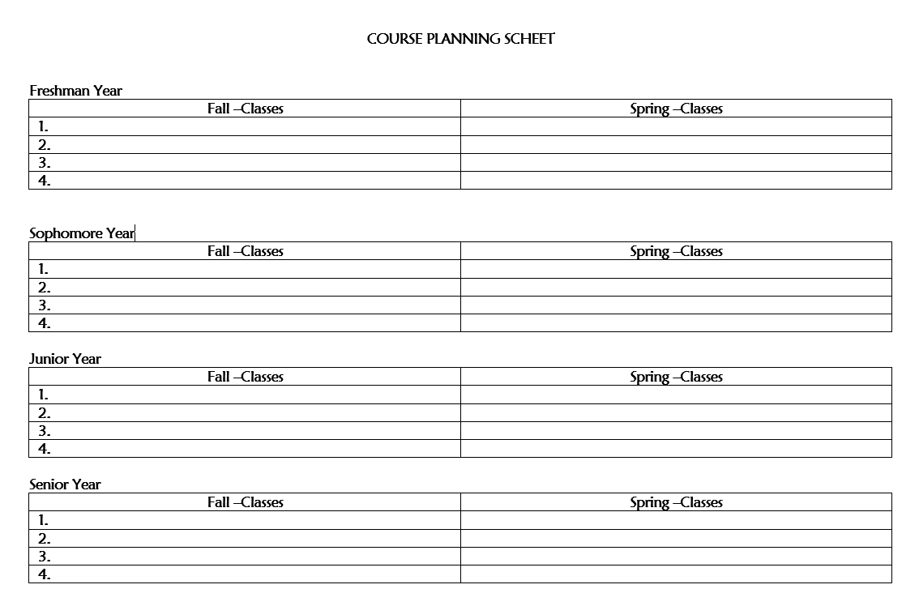
Course Planning

Slide 8
Registration Timeline for 2025-2026 Classes
In January, students will register for their 10th grade electives.
Academic teachers assign students to the next course in sequence.
Students should speak with their teachers regarding what level they would like to be placed in (CP, Honors, or AP).
There will be a short window of time where students can make changes.
Parents should monitor the school newsletter for registration updates.

Slide 9
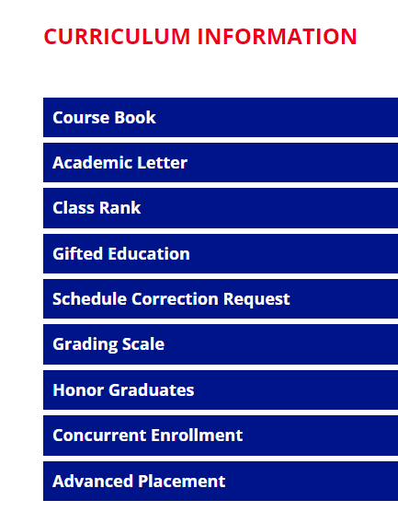
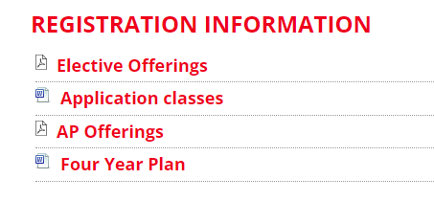
PRHS Curriculum Office Page

Slide 10
Dual Enrollment
Georgia’s Dual Enrollment Program provides funding for students who are dually enrolled at a participating eligible public or private high school and a participating eligible postsecondary institution in Georgia. These students take postsecondary coursework for credit towards both high school graduation and postsecondary degree, diploma, or certificate requirements. The program is offered during all terms of the school year: fall, spring and summer semester.
Grade Level Eligibility:
11th & 12th Graders - Eligible students may take any approved Dual Enrollment courses listed on the Course Directory, at an eligible participating postsecondary institution (USG, TCSG or private).
PRHS Program Director – Chrissie Bolt - chrissie.bolt@gcpsk12.org
  Hosting Dual Enrollment Meeting January 23, 2025

Slide 11
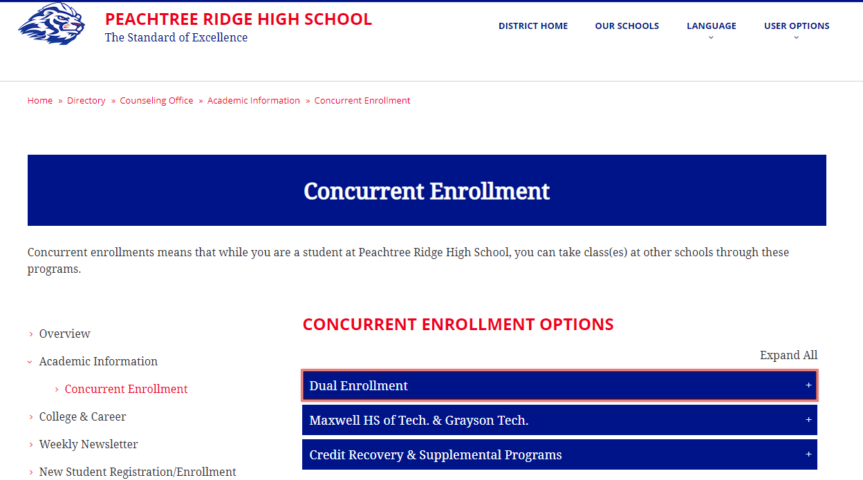
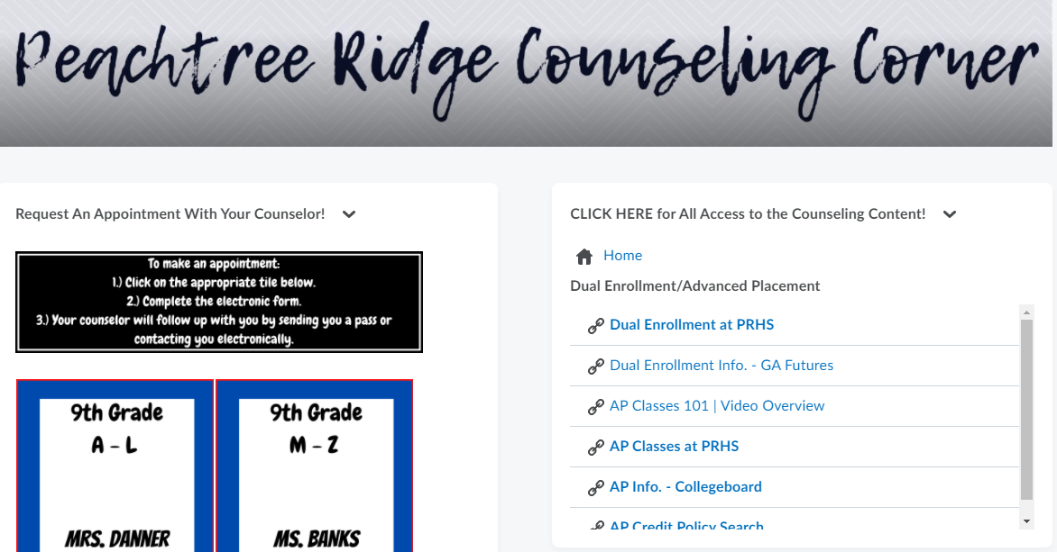
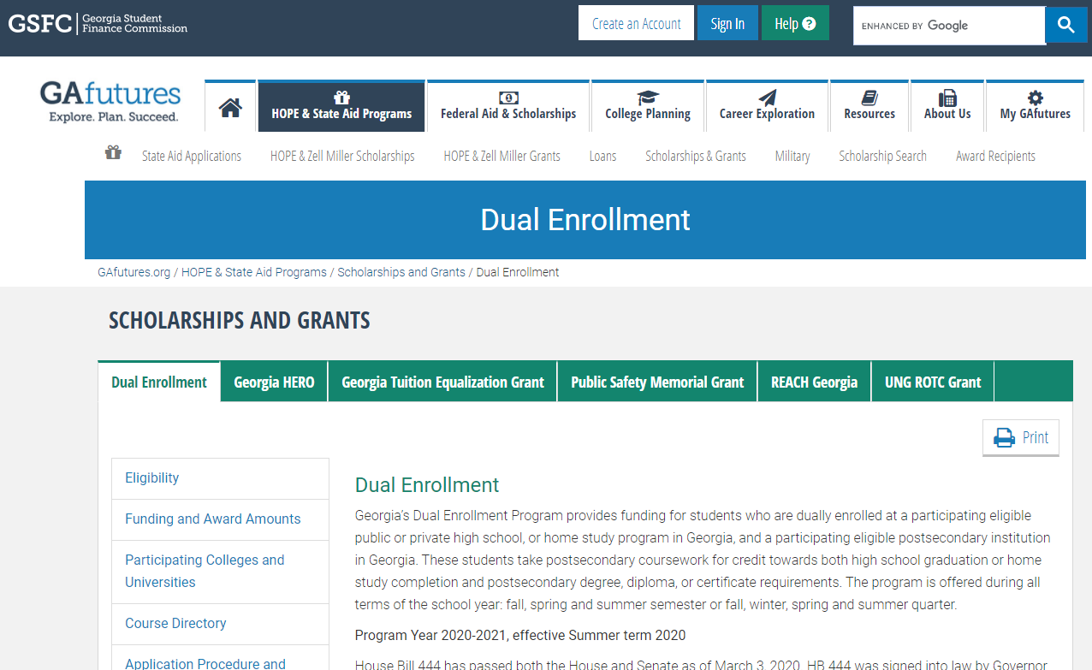
Where to find more info:
PRHS Website
Student eCLASS Page
www.GaFutures.org

Slide 12
Advanced Placement (AP Classes)
Advanced Placement is a program by the College Board which offers college-level curriculum and exams to high school students.
The AP Exam gives a student the possibility to earn college credit.
The college will determine if the score qualifies and how much credit they will award.
Scores: AP Exam scores are reported on a 5-point scale.
Exam score does not affect grade in class.
Advanced Placement Information Session January 23, 2025 @ PRHS

Slide 13
College Admissions: Dual Enrollment vs AP Coursework
An AP course is the highest level offered of the high school curriculum; competitive colleges want to see that you chose that challenge/rigor.
PRHS strongly encourages students who are considering competitive schools to continue with AP courses and potentially balance the AP coursework with some DE course work.
Students should ALWAYS check with the school they wish to attend after graduation to determine whether AP coursework or DE coursework is a preferred pathway.

Slide 14
Core/Academic Classes
Core GPA vs. Cumulative GPA
English
Math
Science
Social Studies
World Language

Slide 15

HOPE Scholarship: Helping Outstanding Pupils Educationally
Merit Scholarship – Financial reward based on academic performance
Georgia's HOPE Scholarship is available to students who are Georgia residents and U.S. citizens
HOPE/Zell Miller is an Annual Scholarship
HOPE Scholarship
  3.0 Core GPA upon graduation
  Pays 80%-100% of Tuition
Zell Miller Scholarship
  3.7 Core GPA
  Pays 100% of Tuition

Slide 16
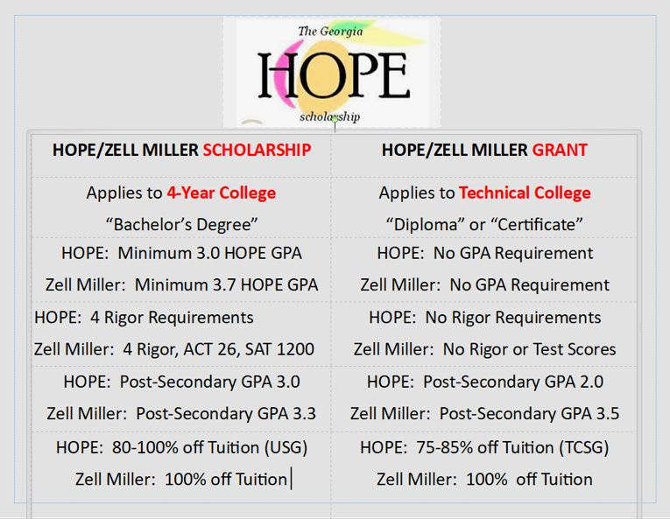
Hope Grant
2 Year College/Technical School
HOPE Grant- No GPA requirement
Must graduate High School!
Hope Grant pays 75- 80%
of Tuition

Slide 17
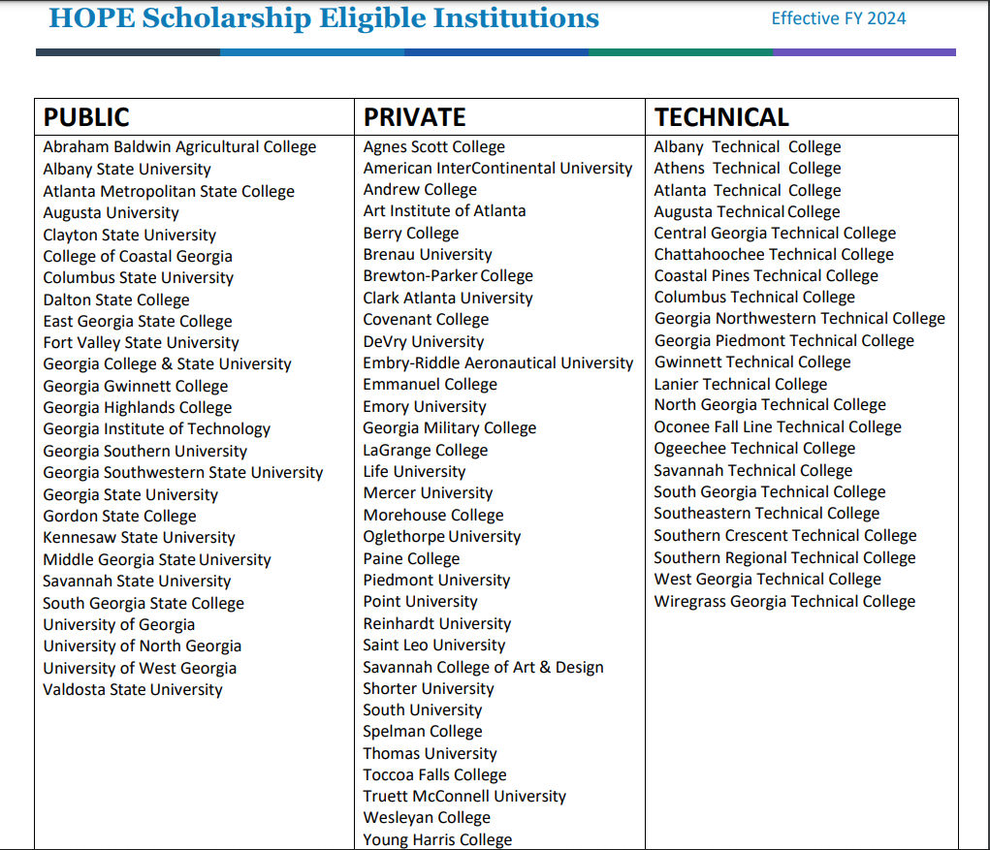

Slide 18

Students should CREATE A GAFUTURES.ORG ACCOUNT
*Use personal email and make sure PRHS has copy of student Social Security Card
See current HOPE/Zell Miller GPA – Finalized in June
Dual Enrollment information & Funding Application
HOPE & State Aid Programs - descriptions and applications
Federal Aid & Scholarships
College Exploration & Planning

Slide 19
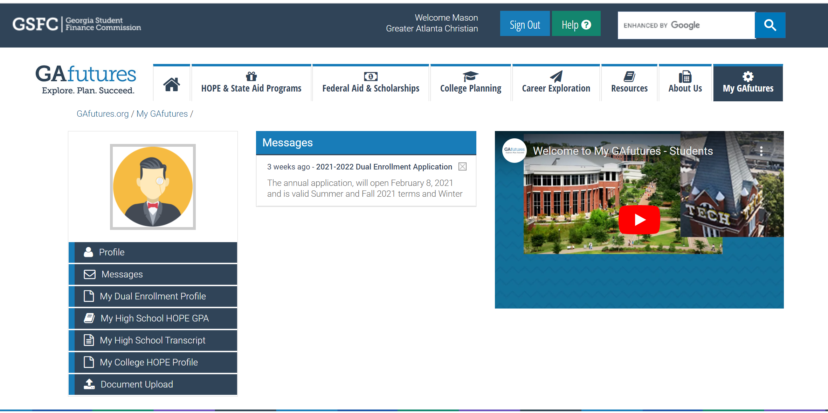
GAfutures.org
School must have Social security number on file

Slide 20
What matters most in the admissions review?
Transcript - GPA/Rigor
Test Scores- SAT/ ACT
Extracurricular activities/Contribution to Community
Personal Essays
Teacher Recommendations

Slide 21






College Admission Requirements & Freshman profiles - College websites make expectations clear -

Slide 22
Timeline of Suggestions
Now:
Focus on grades - keep GPA in mind
4-year course plan
Look at scholarships for requirements
Pursue interests/passions
Summer Opportunities – camps, job, volunteer, job shadow
Explore high school options (Maxwell HS of Tech/Grayson Tech)
Research Post-Secondary options/Costs/Save for college
10th Grade year:
Take PSAT – Free at PRHS
Attend College Fairs
Tour College Campuses
Summer after 10th
  SAT Practice Test: College Board & Khan Academy
  ACT – free class by Kaplan, mock test

Slide 23
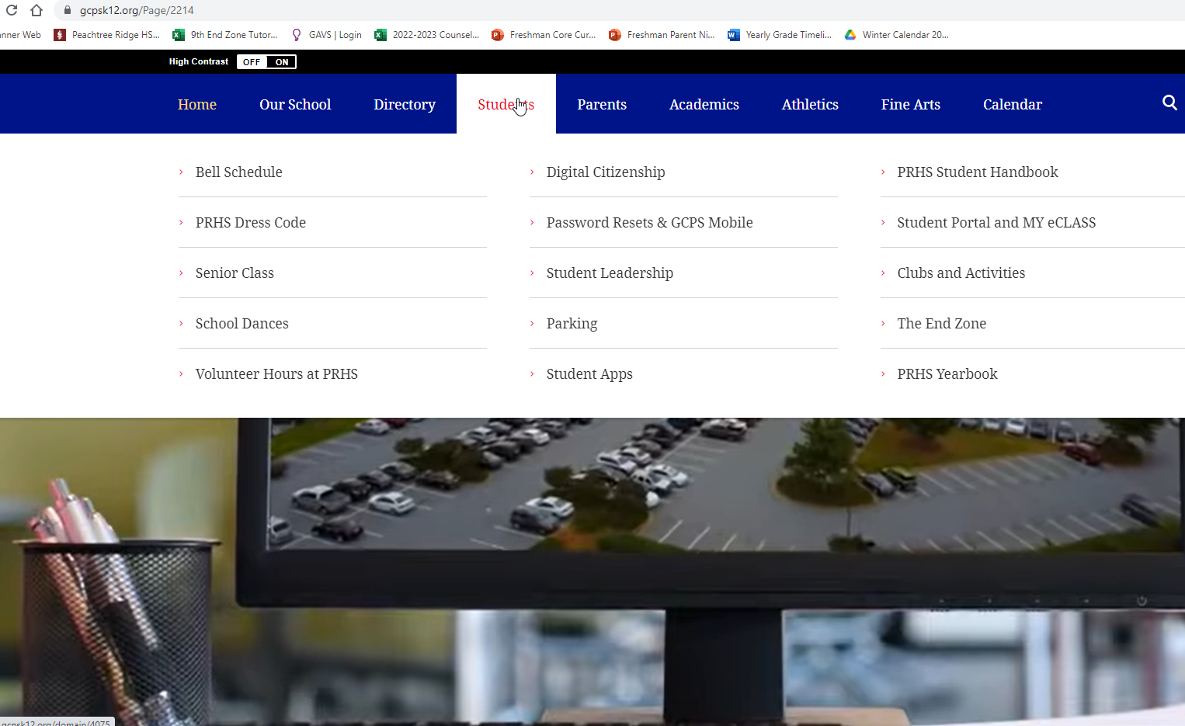
How to log Volunteer Hours

Slide 24
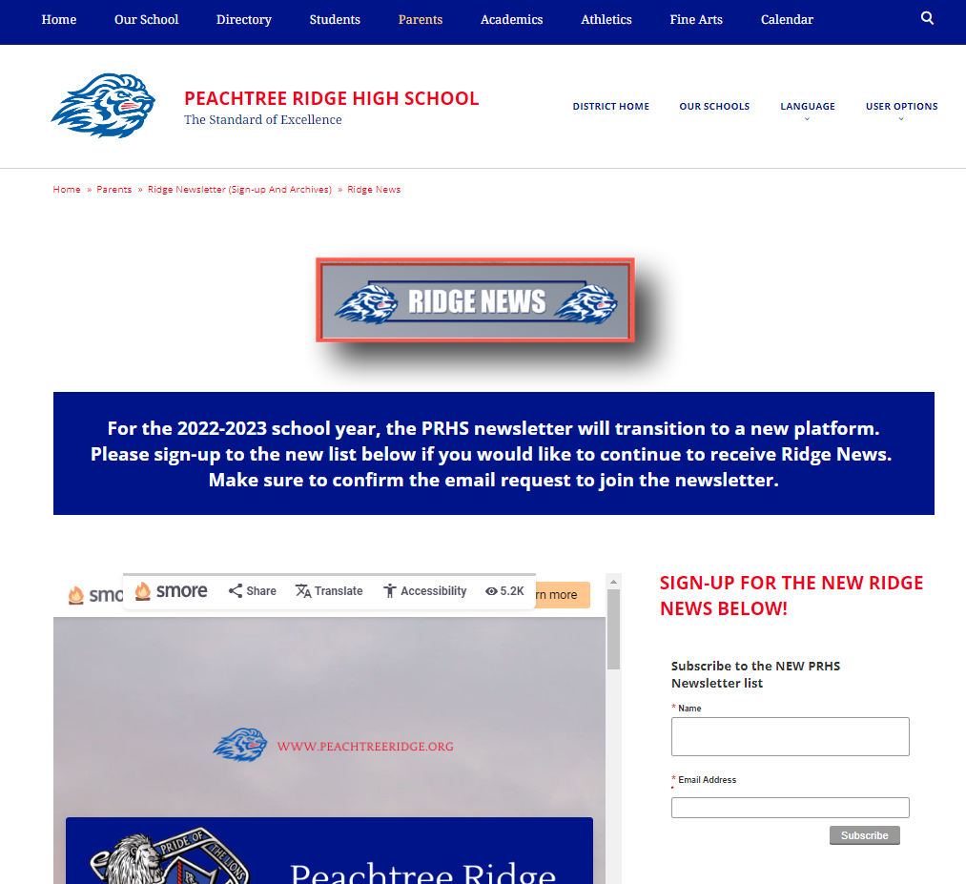

Slide 25
Thank you for taking the time to Support your student!
Counselors
Assistant Principals
A-L: Wanda.Merchant@gcpsk12.org
M-Z:
Aubrey.Banks@gcpsk12.org
Brittany.Devitt@gcpsk12.org
Sean.Oconnor@gcpsk12.org
Students can make an appointment to meet with their counselor via eCLASS
Please complete the survey and drop in the Box on your way out

